Slide 1

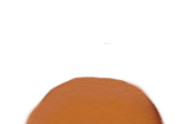


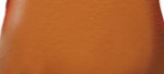

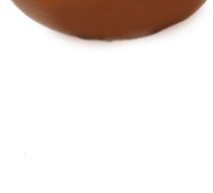
Default Frosh Reset Instructions Save Load
Nose | eyes | arms | feet | head
None mustache | None normal | None exists | None blue | None beanie
The link/button pressed will be highlighted in yellow, and the next page will show the result. This is the starting state.

Slide 2
Default Frosh Reset Instructions Save Load
Nose | eyes | arms | feet | head
None mustache | None normal | None exists | None blue | None beanie

Slide 3
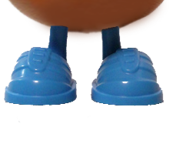
Default Frosh Reset Instructions Save Load
Nose | eyes | arms | feet | head
None mustache | None normal | None exists | None blue | None beanie

Slide 4

Default Frosh Reset Instructions Save Load
Nose | eyes | arms | feet | head
None mustache | None normal | None exists | None blue | None beanie

Slide 5
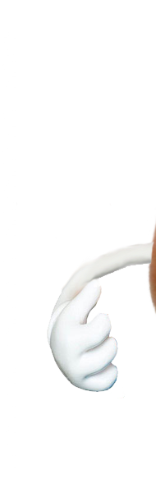
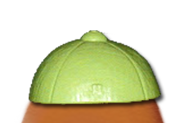
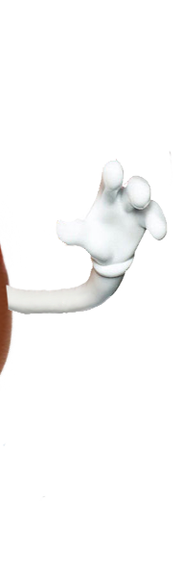
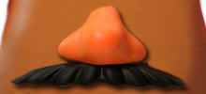

Default Frosh Reset Instructions Save Load
Nose | eyes | arms | feet | head | Item
None mustache | None normal | None exists | None blue | None beanie | None fishing

Slide 6
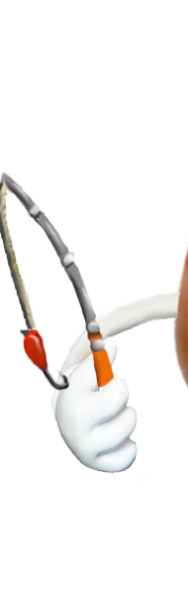
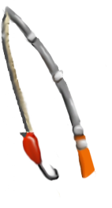
Default Frosh Reset Instructions Save Load
Nose | eyes | arms | feet | head | Item
None mustache | None normal | None exists | None blue | None beanie | None fishing
OR
(both are acceptable)

Slide 7
Default Frosh Reset Instructions Save Load
Nose | eyes | arms | feet | head
None mustache | None normal | None exists | None blue | None beanie

